Slide 1
💡 Predict Tomorrow’s Pay Today
CAPSTONE PROJECT
Presented By:
1. Sara Mamatha (Computer Science & Data Science Engineering)

Slide 2
OUTLINE
Problem Statement
System Development Approach
Algorithm & Deployment (Step by Step Procedure)
Result
Conclusion
Future Scope
References

Slide 3
Problem Statement
In today’s competitive job market, determining fair and accurate employee compensation is a major challenge for organizations and individuals alike. Manual salary estimation methods are often time-consuming, biased, and inconsistent due to the complexity of influencing factors such as education, experience, industry, job role, and work hours. There is a growing need for a data-driven, automated solution that can predict salaries reliably and instantly using real-world attributes.

Slide 4
System Approach
System Requirements
Hardware Requirements:
Processor: Intel i5 or higher
RAM: Minimum 4 GB (8 GB recommended)
Storage: At least 500 MB of free space
Operating System: Windows 10/11, Linux, or macOS
Software Requirements:
Python 3.8 or higher
Web browser (Chrome, Firefox, Edge)
Streamlit (for web app UI)

Slide 5
Libraries Required
Library | Purpose
pandas | Data manipulation and preprocessing
numpy | Numerical operations
scikit-learn | Building and training the ML model
joblib | Saving and loading the trained model
matplotlib / seaborn | (Optional) Data visualization during EDA
stream lit | Building the interactive web application
pickle | (Optional) Model serialization (alternative to joblib)

Slide 6
Algorithm & Deployment
Algorithm Used: Gradient Boosting Regressor
I have selected Gradient Boosting Regressor because it:
Builds strong predictive models through sequential tree learning
Handles both linear and non-linear patterns effectively
Reduces bias and variance through boosting
Performs exceptionally well on structured/tabular datasets

Slide 7
Step-by-Step Procedure
Data Preparation: Collected employee dataset with 13 relevant features, handled missing values, and encoded categorical data.
Model Training: Trained a Gradient Boosting Regressor for salary prediction using scikit-learn.
Model Saving: Saved the trained model as best_model.pkl using joblib.
UI Development: Built an interactive and modern Streamlit web app for salary prediction using user input.

Slide 8
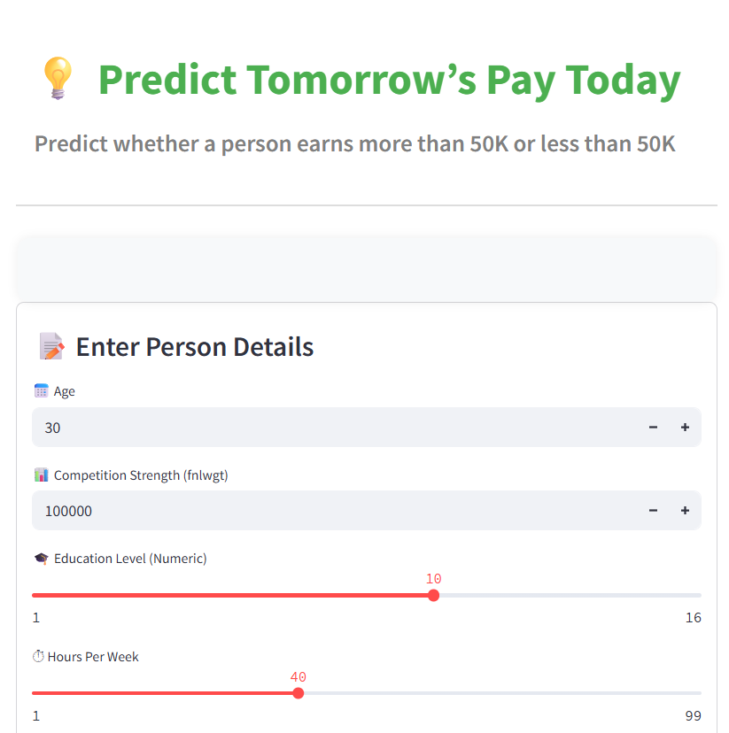
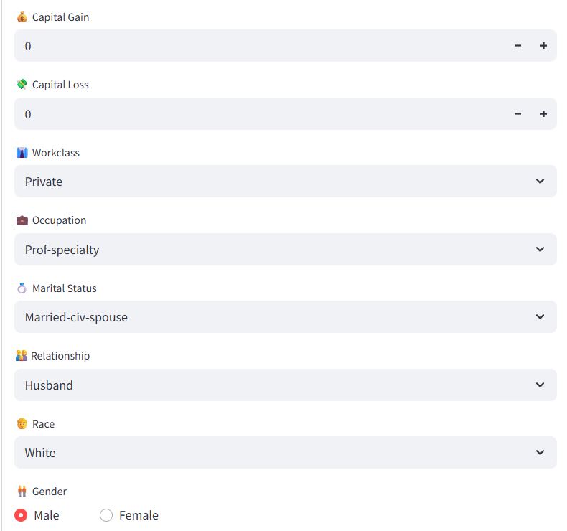
Result

Slide 9
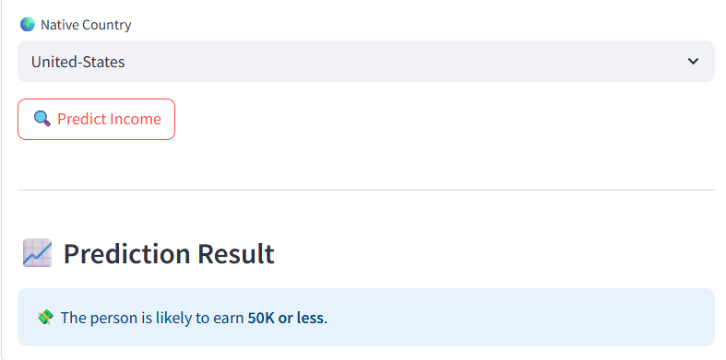
RESULT

Slide 10
GITHUB LINK
https://github.com/mamathasara/Predict_Tomorrows_Pay_Today
Project link
http://localhost:8501/

Slide 11
Conclusion
Summary & Effectiveness
In my project "Predict Tomorrow’s Pay Today", I built a machine learning model to predict employee salaries using features like education, job type, working hours, and marital status. After testing different models, the Gradient Boosting Regressor gave the best results with high accuracy. This model was effective because it handled complex relationships between features and salary.

Slide 12
Challenges Faced:
>The dataset had missing and messy values, so I spent time cleaning and preparing it.
>Choosing the right model took effort—I had to try different algorithms and compare their performance.
Ensuring the model didn’t overfit the training data was another challenge.
Possible Improvements:
>I can improve the model further by using hyperparameter tuning.
>Adding more features like years of experience or industry might boost accuracy.
>I can also use explainable AI tools to better understand how the model makes predictions.

Slide 13
Future scope(Optional)
In the future, this Employee Salary Prediction system can be made even better by adding more details like years of experience, skills, and job roles to improve accuracy. We can use advanced models like deep learning to understand more complex patterns in the data. The system can also be turned into a live website where users can enter their details and get instant salary predictions. To help users understand how the prediction was made, we can add tools that explain which factors affected their salary the most. An interactive dashboard can also be built to help HR teams make better decisions. If we collect data from different locations and industries, the system can give more specific and useful predictions. Finally, we can automate the model to update itself whenever new data is available, so it stays accurate over time.

Slide 14
References
Pandas & NumPy Docs – For data cleaning and manipulation.
https://pandas.pydata.org/ | https://numpy.org/
Scikit-learn – For encoding, model building, and evaluation.
https://scikit-learn.org/
Matplotlib & Seaborn – For data visualization.
https://matplotlib.org/ | https://seaborn.pydata.org/
Kaggle – For accessing the employee salary dataset.
https://www.kaggle.com/
BM SkillsBuild Internship – For real-world project structure and guidance.
Blogs & Books – Helped understand ML concepts.
Hands-On ML with Scikit-Learn & TensorFlow
https://towardsdatascience.com/

Slide 15
THANK YOU

